Slide 1
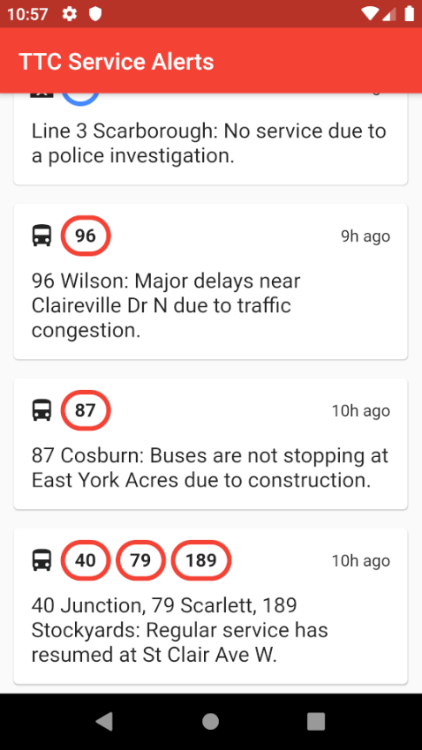
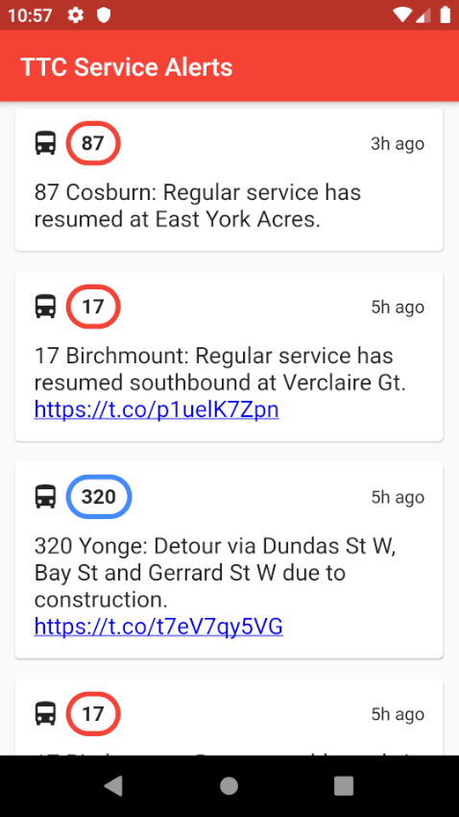

TTC Service Alerts
Always be informed of the latest TTC service interruptions
Never be late again
Get up to date information on buses, streetcars, and subways

